Slide 1
Regional Training on Hydrodiplomacy & Negotiation Skills for
IGAD Water Resources Protocol Negotiation Members
27-28 February 2017 -- Addis Ababa, Ethiopia
Water-energy security nexus:
The Aral Sea basin case
Sergei Vinogradov

Slide 2
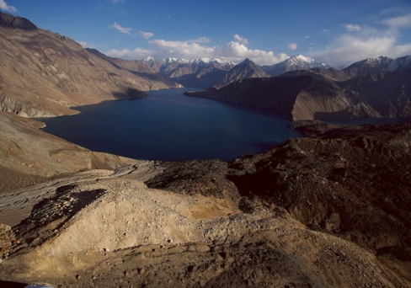
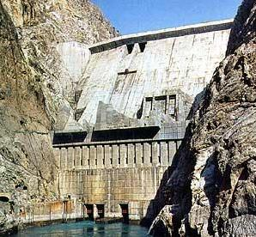
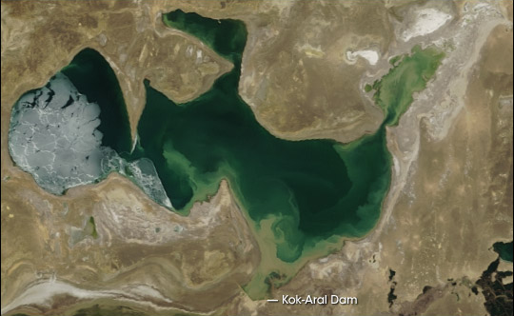

Outline
Context: the Aral Sea basin
Transboundary water
issues
Legal framework: evolution & current challenges

Slide 3
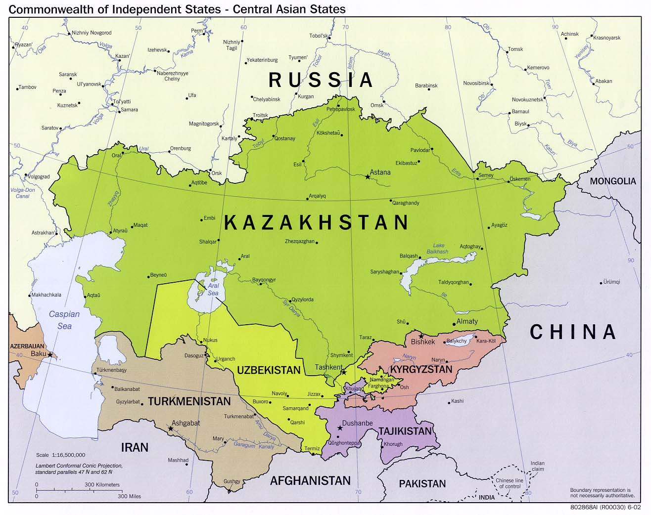

Slide 4
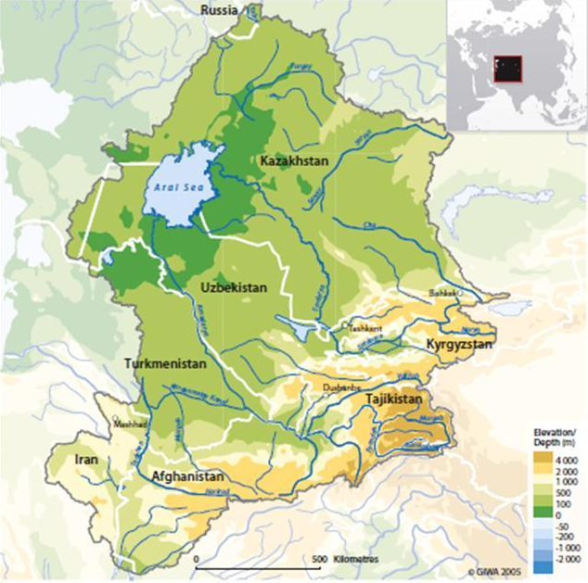
Aral Sea Basin
Total area: 1,231,400 km²
Basin countries:
Kazakhstan, Kyrgyz Republic, Tajikistan, Turkmenistan, Uzbekistan + Afghanistan, Iran, China,
Population: ~ 35 mln,
of which 3.5 mln live in the
disaster zone (60 mln in CA)
Two main rivers:
Syrdarya (36.6 km³/year)
Amudarya (79 km³/year)
Total surface runoff:
116 km³/year

Slide 5
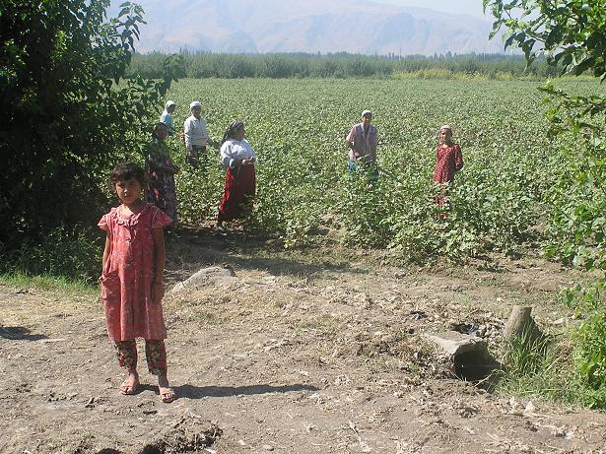
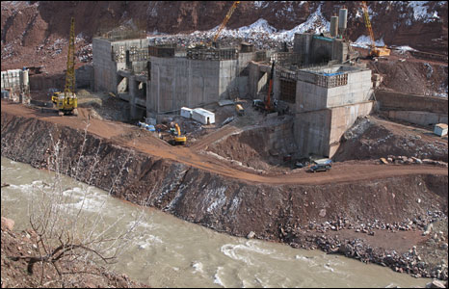
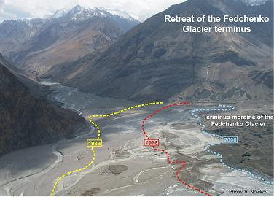
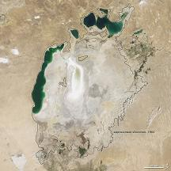
Transboundary water issues
Water
(Irrigation/Food)
Energy
(Hydropower)
Environment

Slide 6
Water-Energy-Environment

Slide 7
Water Balance in the Aral Sea Basin
(billion cubic meters)
Water balance in the Aral Sea Basin
80 Amu Darya
Syr Darya 40
120
10
110
45
Water Users
10 River losses
20
9 Groundwater recharge
16 To depressions
Aral Sea

Slide 8
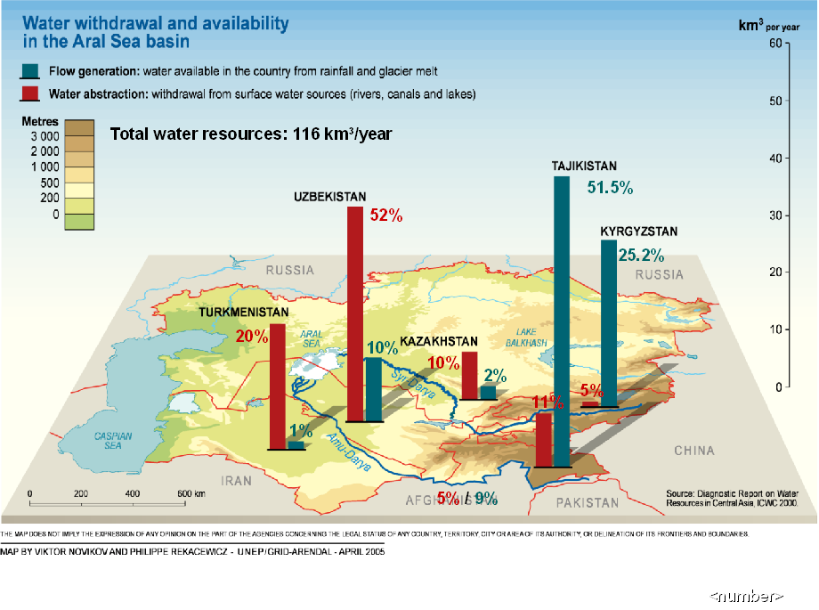

Slide 9
Dependency on irrigation
 | Kz | Kg | Tj | Tm | Uz
Rural population, % | 44 | 66 | 72 | 55 | 63
Internal water resources per inhabitant m³/year | 4664 | 9439 | 10153 | 287 | 657
Dependence on transboundary water ratio*, % | 31 | 0 | 0 | 94 | 77
Water withdrawal for irrigation, % | 80 | 94 | 87 | 97 | 92
Agricultural output supported by irrigation, % of GDP | 8 | 39 | 23 | 25 | 39
* The dependency ratio is equal to the part of the water resources which originates outside the country
An estimated 22 million people depend directly or indirectly on irrigated agriculture in CARs. 2005 UN Report.

Slide 10
Water-Energy-Environment

Slide 11
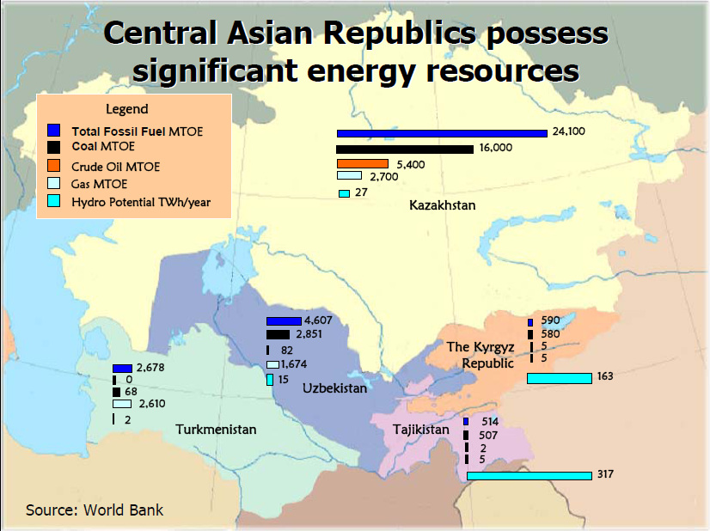

Slide 12
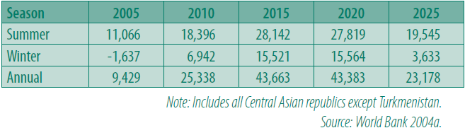
Surplus electricity available for trade
Central Asia (GWh)

Slide 13
Water-Energy-Environment

Slide 14
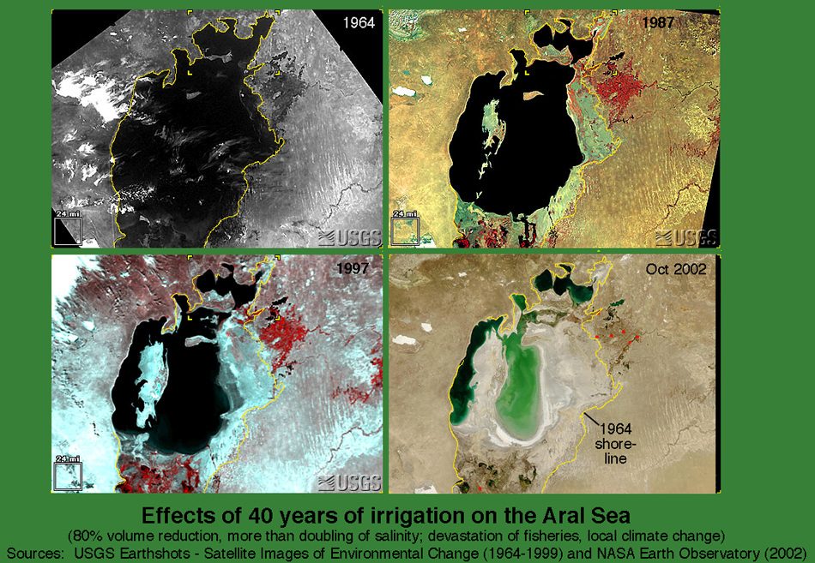

Slide 15
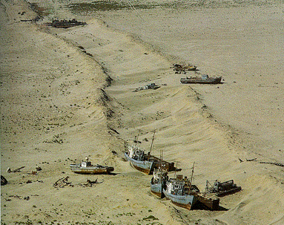

Slide 16
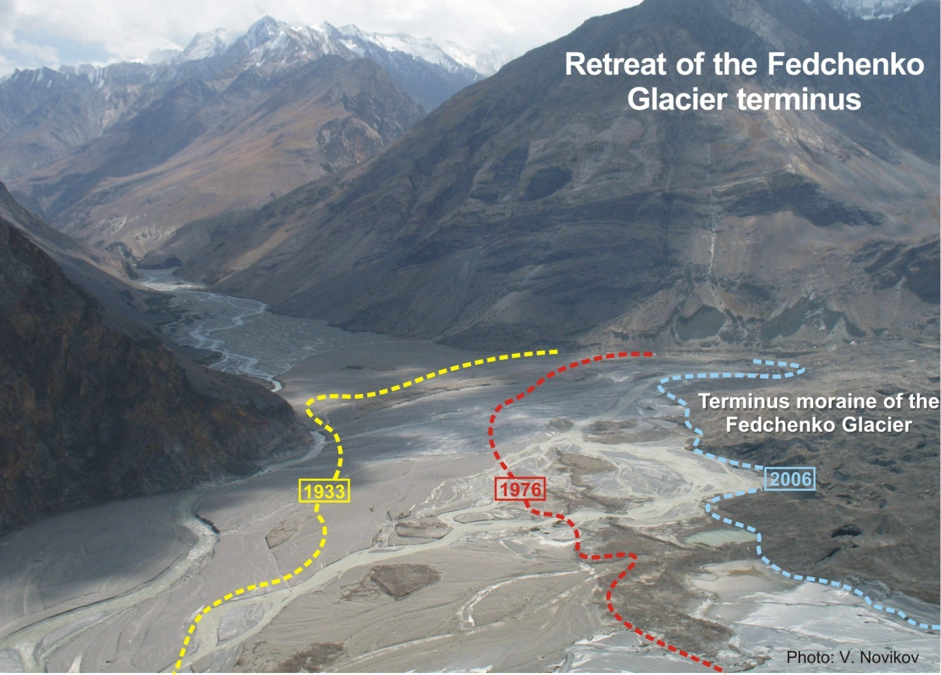
Global climate change: Glacier melting

Slide 17
Transboundary water challenges
Increasing demand - population growth, economic development, Afghanistan
Diminishing supply - water quality & climate change
Conflicting interests - changing the regime of existing reservoirs/building new dams & irrigation/food & ecosystems
Ensuring Water for All

Slide 18
Treaties & other instruments at basin level
  1992 Almaty Agreement – Soviet management status quo, institutions (ICWC, BWOs)
  1993 Kzyl-Orda Agreement – Joint activities on Aral Sea crisis
  1996 Agreement – Uzb & Tm water use on Amudarya: 50/50 sharing
  1998 Syrdarya Agreement – Water and energy use in Syrdarya basin
  1998 Environmental Cooperation Agreement - (Kz, Kz & Uzb)
  1999 Parallel Operation of the Energy Systems of CARs
  1999 Int’l Fund for saving Aral Sea (IFAS) status Agreement
  2006 Convention on Sust. Dev’t in CARs (not in force, signed Kz, Tj, Tm)
  The Aral Sea Basin Programs

Slide 19
Participation in global and regional conventions
Convention | Kz | Kg | Tj | Tm | Uz
1997 UN Water |  |  |  |  | √
1992 UNECE Water | √ |  |  |  | √
1998 CIS | s |  | √
1991 Espoo | √ | √
1992 Industrial accidents | √
1998 Aarhus | √ | √ | √ | √
1971 Ramsar | √ | √ | √ | √ | √
1997 UN - Convention on the Non-navigational Uses of International Watercourses; 1992 UNECE - Convention on the Protection and Use of Transboundary Watercourses and International Lakes; 1998 CIS- Agreement on the Main Principles of Interactions in the field of Rational Use & Protection of Transboundary Watercourses of the CIS; 1991 Espoo - Convention on Environmental Impact Assessment in a Transboundary Context; 1992 Industrial Accidents - Convention on the Transboundary Effects of Industrial Accidents; 1998 Aarhus - Convention on Access to Information, Public Participation in Decision-Making and Access to Justice in Environmental Matters; 1971 Ramsar - Convention on Wetlands of International Importance, especially as Waterfowl Habitat

Slide 20
The matters of scope in the Aral Sea Basin
Existing agreements do not cover all basin states
Groundwaters & ecosystems are not specified enough
No watercourse-specific agreements

Slide 21
Regional institutional mechanisms
International Fund for Saving the Aral Sea (IFAS) –
  Executive Committee and 2 regional commissions: on water coordination and on sustainable development (environmental)
  Lacks authority to resolve regional water-related problems
Interstate Commission for Water Coordination (ICWC) and Basin water management organizations (BWOs)
  Lack mandate to monitor and control
  No compliance review

Slide 22
Concluding remarks
Water is a matter of security at multiple levels:
a source of livelihoods a vector of pathogens, a potent force behind extreme events and natural disasters, a mechanism for cooperation among governments and communities.
The Asia Society’s Leadership Group on Water Security (2009)
Law provides a framework at multiple levels:
  Transboundary watercourses treaties at basin, regional and global levels
  Other relevant treaties (MEAs, energy, human rights, etc) and general international law

Slide 23
Concluding remarks: Legal framework in the ASB
A wide range of treaty and customary obligations
But indeterminacy & vagueness of basin treaty provisions, lack of monitoring & compliance mechanism,
lack or ineffectiveness of institutional & dispute settlement mechanism
Deteriorating cooperation

